Slide 1
Image Segmentation for Solder Defect Inspection
Presenter: Kai-Ching Yen 閻楷青
Phone: 0932371193
E-Mail: kcy070586@gmail.com
Advisor: Prof. Chiou-Shann Fuh 傅楸善 教授

Slide 2
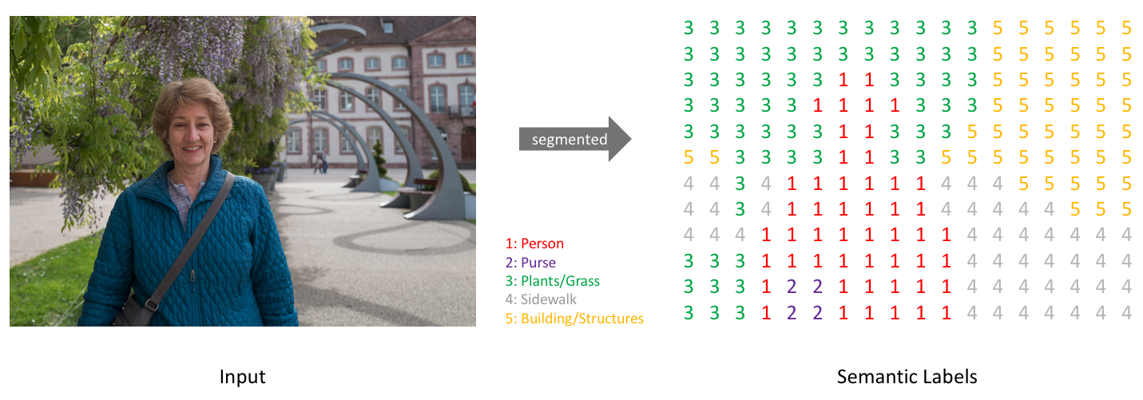
Semantic Segmentation
A classification problem of pixels with semantic labels.
Perform pixel-level labeling with a set of object categories (e.g., human, car, tree, sky), so it is generally harder than image classification.

Slide 3
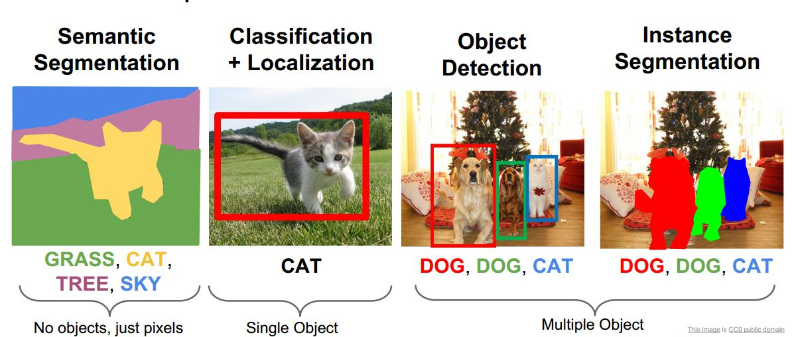
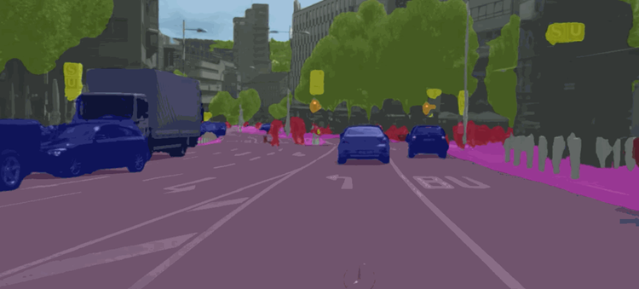
Semantic Segmentation

Slide 4
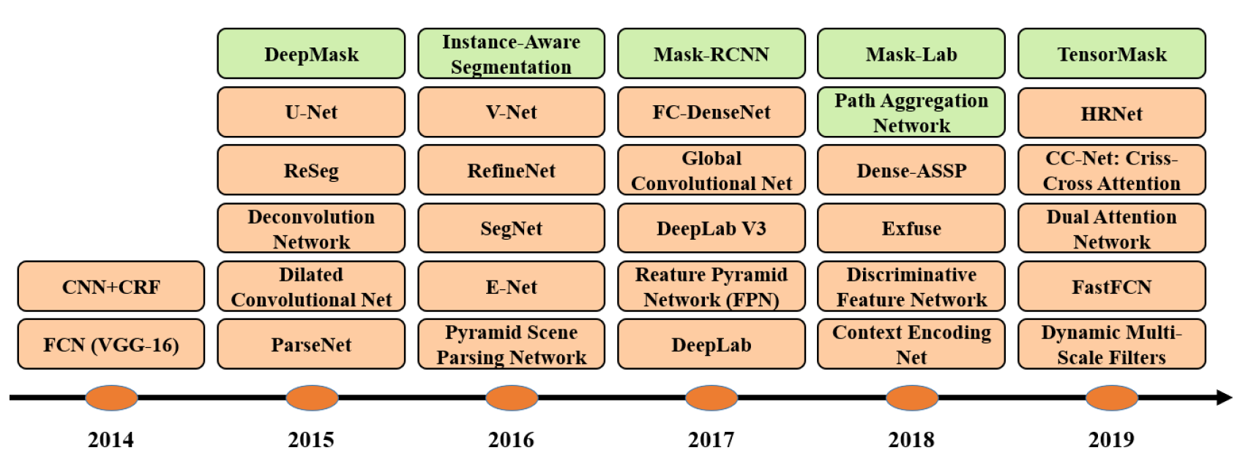
DL-Based Image Segmentation Models
RCNN: Region-based Convolutional Neural Network
HRNet: High-Resolution Network
ASPP: Atrous Spatial Pyramid Pooling
ASPP

Slide 5
DL-Based Image Segmentation Models
1. Fully Convolutional Networks (FCN)
2. Convolutional Models With Graphical Models
3. Encoder-Decoder-Based Models
4. Multi-Scale and Pyramid Network-Based Models
5. R-CNN-Based Models
6. Dilated Convolutional Models and DeepLab Family
7. Recurrent Neural Network-Based Models
8. Attention-Based Models
9. Generative Models and Adversarial Training

Slide 6
DL-Based Image Segmentation Models
Fully Convolutional Networks (FCN)
Convolutional Models With Graphical Models
Encoder-Decoder-Based Models
Dilated Convolutional Models and DeepLab Family

Slide 7
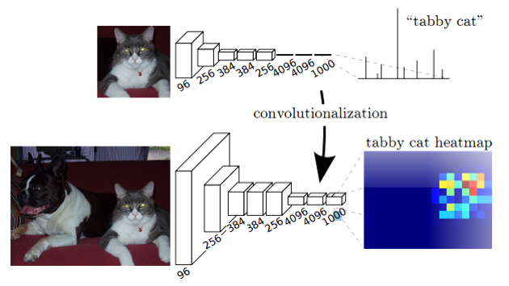
Fully Convolutional Networks (FCN)
Take an image of arbitrary size & produce a same-size segmentation map.
Replacing all fully-connected layers with the fully-convolutional layers.
Outputs a spatial segmentation map, not classification scores.

Slide 8
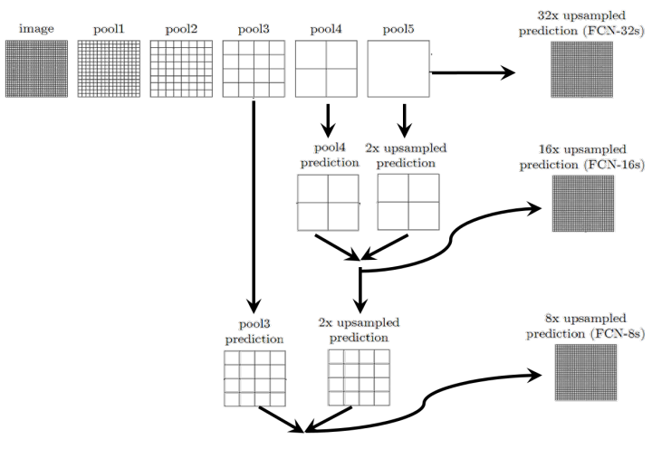
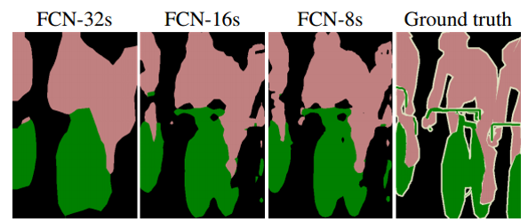
Fully Convolutional Networks (FCN)
Skip connections
Combine coarse, high-level information and fine, low-level information:

Slide 9
Fully Convolutional Networks (FCN)
PAMI, 2016
Dataset: PASCAL VOC 2012.
mIoU: 67.2%.
Limitations:
Not fast enough for real-time inference.
Does not take into account the global context information efficiently.
Not easily transferable to 3D images.
PAMI: IEEE Transactions on Pattern Analysis and Machine Intelligence
PASCAL: Pattern Analysis, Statistical Modelling and Computational Learning Visual Object Classes
VOC: Visual Object Classes
mIoU: mean Intersection over Union

Slide 10
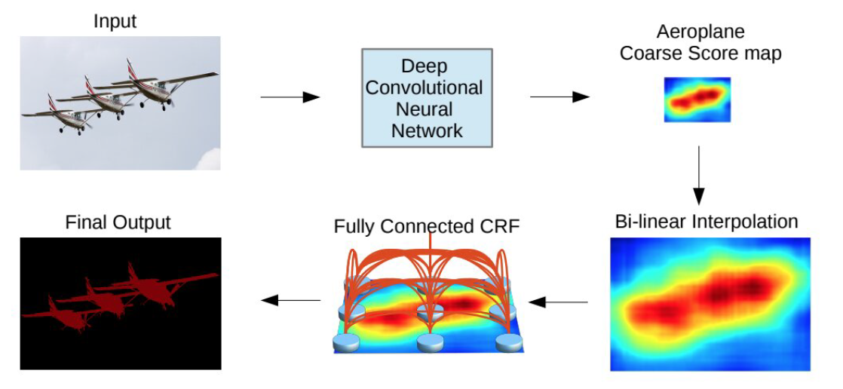
Convolutional Models with Graphical Models
Incorporate probabilistic graphical models into DL architectures
Conditional Random Fields (CRFs)
Markov Random Fields (MRFs)
A CNN+CRF model.
Notes:
Incorporate 合併
bi-linear interpolation(upsampled + fully-connected CRF ： refine(提煉、精確) the segmentation result

Slide 11
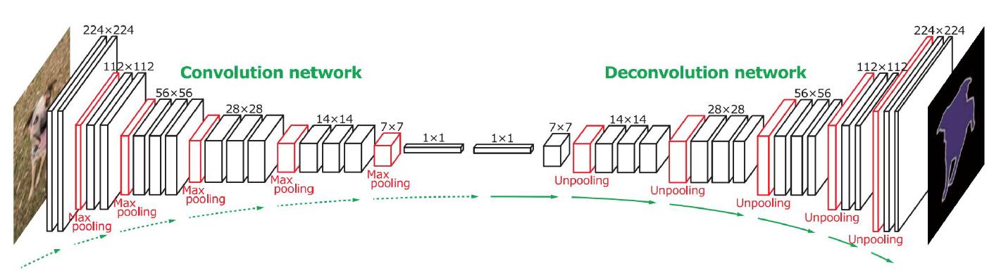
Encoder-Decoder-Based Models
Deconvolutional semantic segmentation.
Deconvolution layers
Unpooling layers
Notes:
Deconvolution：feature vector (input) / a map of pixel-wise class probabilities (output)

Slide 12
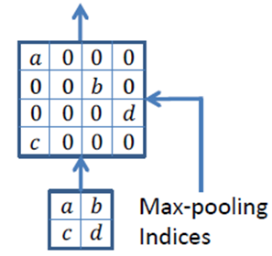
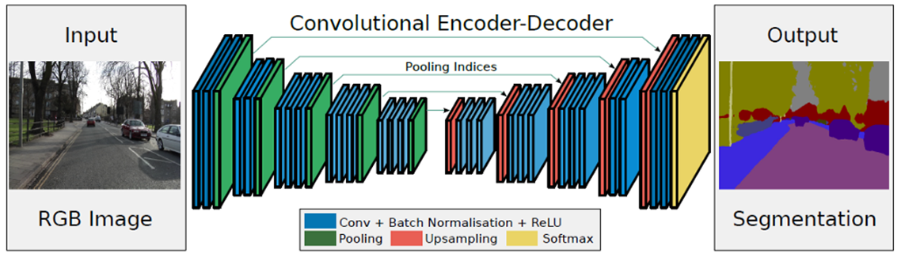
Encoder-Decoder-Based Models
SegNet: Segmentation Network
VGG: Visual Geometry Group
RGB: Red, Green, Blue
ReLU: Rectified Linear Unit
SegNet
(2016)
mIoU: 60.1%.
Dataset: CamVid 11.
Encoder: 13 convolutional layers (VGG16) + 3 fully convolutional layers.
Eliminates the need for learning to up-sample.
Notes:
少很多training的參數量
Indices： 這些稀疏的maps 接著會被 convolved with trainable filters 來產生 dense feature maps.

Slide 13
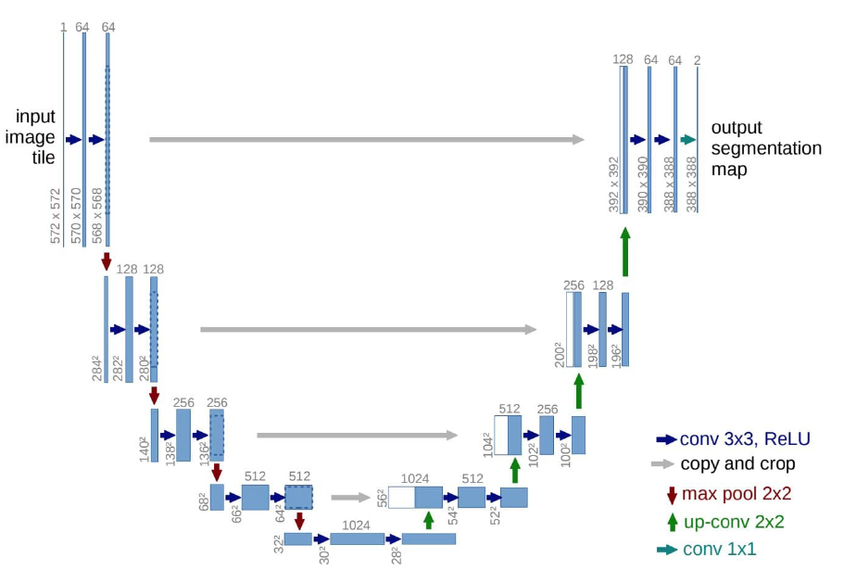
Encoder-Decoder-Based Models
U-Net
Initially for medical and biomedical image segmentation.
Inspired by FCNs and encoder-decoder models.
Feature maps from the down-sampling part are copied to the up-sampling part to avoid losing pattern information.
Others: U-Net for 3D images, nested U-Net, …
Notes:
FCN-like：類似 skip connection
在相加的方式下，feature map 的維度沒有變化，但每個維度都包含了更多特徵，對於普通的分類任務這種不需要從 feature map 復原到原始解析度的任務來說，這是一個高效的選擇；而拼接則保留了更多的維度/位置 信息，這使得後面的 layer 可以在淺層特徵與深層特徵自由選擇，這對語義分割任務來說更有優勢。 FCN 中深層信息與淺層信息融合是通過對應像素相加的方式，而 Unet 是通過拼接的方式。

Slide 14
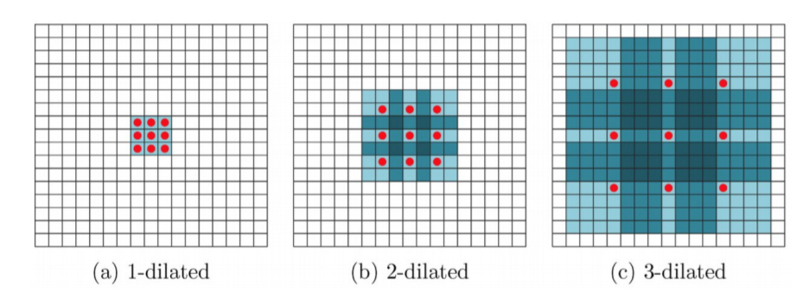
Dilated Convolutional Models and the DeepLab Family
MS: MicroSoft
COCO: Common Object in COntext
Also called “Atrous Convolution”.
Enlarging the receptive field with no increase in computational cost.
The DeepLab family, densely connected Atrous Spatial Pyramid Pooling (DenseASPP), Efficient neural Network (ENet).
DeepLabv3+：high mIoU of 89.0% on PASCAL VOC 2012. (pretrained on MS-COCO)
4-dilated

Slide 15
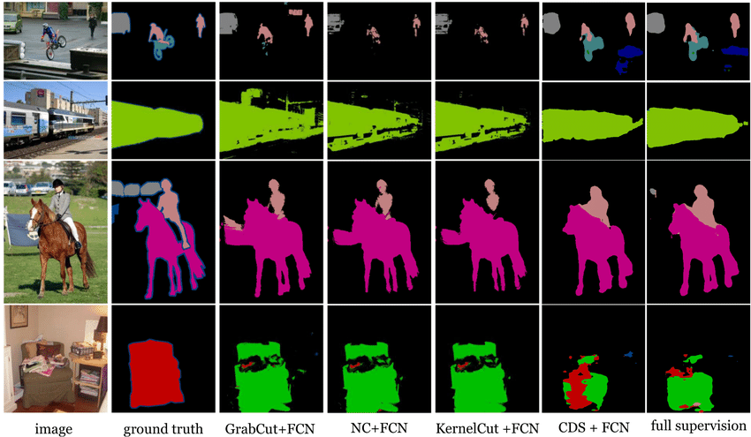
Dataset
PASCAL Visual Object Classes (VOC)
Annotated images available for 5 tasks—classification, segmentation, detection, action recognition, and person layout.
21 classes of object labels.
Pixel are labeled as background if they do not belong to any of these classes.
PASCAL Context
An extension of the PASCAL VOC 2010.
Contains more than 400 classes.
Many of the object categories of this dataset are too sparse.
Notes:
Hybrids 混合
person layout 人員布局

Slide 16
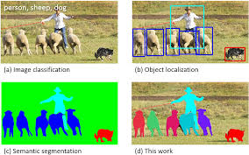
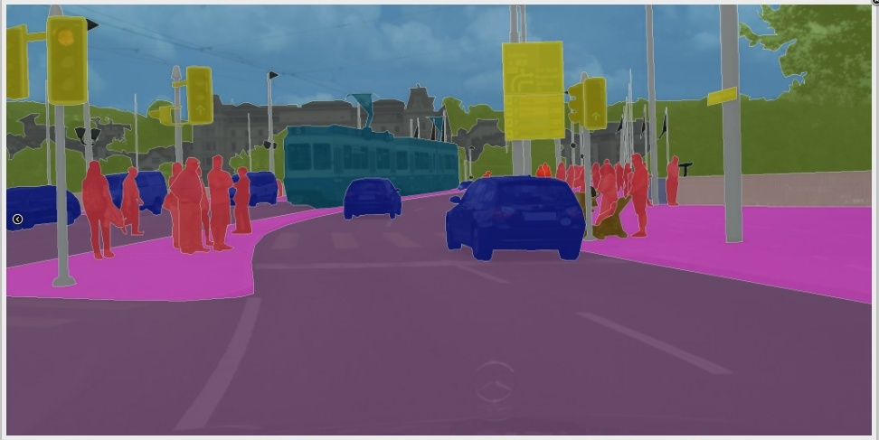
Dataset
Microsoft Common Objects in Context (MS COCO)
Large-scale object detection, segmentation, and captioning dataset.
Includes images of complex everyday scenes and common objects.
Mainly for segmenting individual object instances.
Cityscapes
Focus on semantic understanding of urban street scenes.
Contains a diverse set of stereo video sequences.
Notes:
Stereo 立體聲

Slide 17
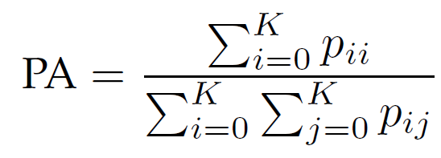
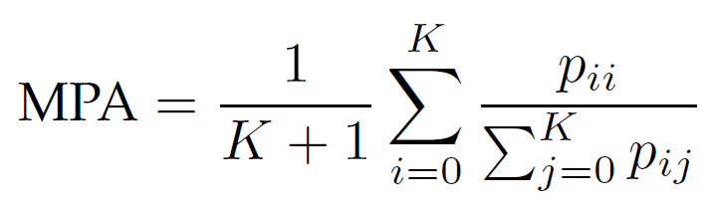
Metrics for Segmentation Models
Pixel Accuracy (PA):
PA
The ratio of pixels properly classified, divided by the total number of pixels.
Mean Pixel Accuracy (MPA):
MPA
The ratio of correct pixels is computed in a per-class manner and then averaged over the total number of classes.

Slide 18
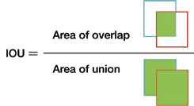
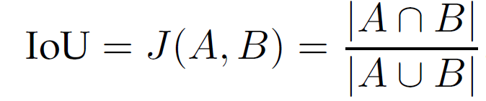
Metrics for Segmentation Models
Intersection over Union (IoU):
IoU
Also called Jaccard Index
The most commonly used metrics in semantic segmentation. (mean-IoU/mIoU)
A denotes the ground truth and B denotes the predicted segmentation maps.

Slide 19
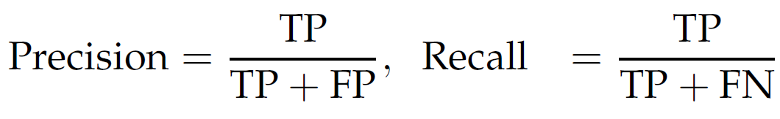
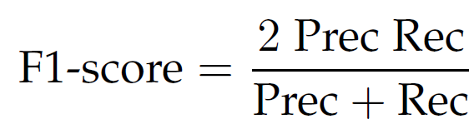
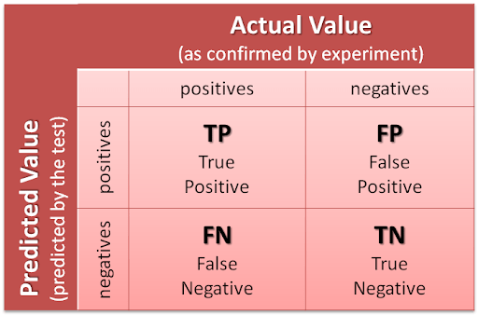
Metrics for Segmentation Models
TP: True Positive
FP: False Positive
FN: False Negative
Precision / Recall / F1 score:
P
F1
F1: harmonic mean of precision and recall
Notes:
調和平均數 (Harmonic mean)

Slide 20
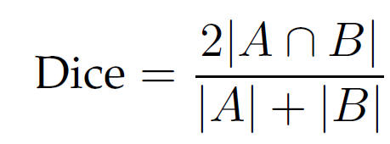
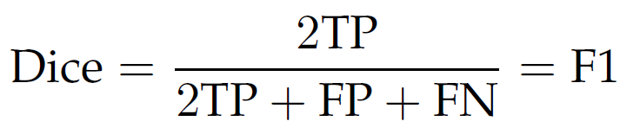
Metrics for Segmentation Models
Dice coefficient:
Dice
Dice
Essentially identical to the F1 score.
The Dice coefficient and IoU are positively correlated.
Notes:
調和平均數 (Harmonic mean)

Slide 21
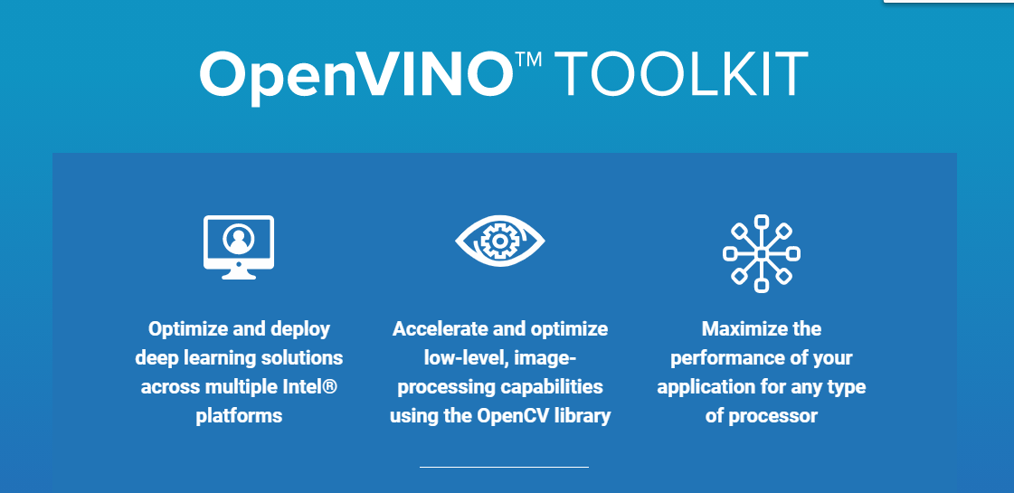
Intel OpenVINO
OpenVINO: Open Visual Inference and Neural network Optimization
OpenCV: Open Computer Vision
GPU: Graphic Processing Unit
CPU: Central Processing Unit
AMD: Advanced Micro Devices
Do not support Nvidia GPU.
Notes:
這工具包主要是協助快速開發電腦視覺應用的解決方案，
整合優化
在硬體上的加速優化，提供在邊緣運算上較低算力的硬體做CNN推論應用開發。
提供多個已訓練好的視覺分類、偵測、分割模型。
支持主流的深度學習框架如Caffe, TensorFlow, MXNet, Kaldi pytorch(ONNX)。

Slide 22
OpenVINO
MacOS: Macintosh Operating System
FPGA: Field Programmable Gate Array
Supports
System environment: Linux, Windows, FPGA, MacOS.
Programming language: C++, Python.
Can be used in Docker.
Notes:
FPGA 現場可程式化邏輯閘陣列 /場域可編程邏輯閘陣列
Docker 是開放原始碼專案，將應用程式自動化部署為可攜式且可自足的容器，在雲端或內部部署上執行。

Slide 23
OpenVINO
OpenCL: Open Computing Language
SDK: Software Development Kit
Including：
Deep Learning Deployment Toolkit (DLDT)
Deep Learning Model Optimizer
Deep Learning Inference Engine
Samples
Tools
Open Model Zoo
OpenCV
OpenCL™ version 2.1
Intel® Media SDK
OpenVX*
Notes:
Deep Learning Model Optimizer — 將不同框架訓練出來的模型做格式轉換和優化模型參數
Deep Learning Inference Engine — 模型推論的API接口，針對不同硬體類別做模型掛載
Tools — 模型準確率驗證、模型校正、模型量化等工具

Slide 24
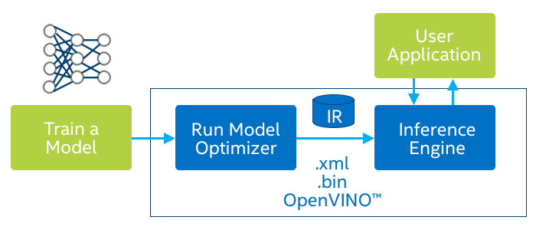
OpenVINO
ONNX: Open Neural Network Exchange
TF: TensorFlow
XML: eXtensible Markup Language
Model Optimizer:
Transfer the trained models (e.g. TF, Caffe, ONNX) into the format for OpenVINO, .bin and .xml.
.xml file (about 2.5 MB) preserves network and parameters, while .bin (about 200 kB) preserves weights and bias.
The model will optimize based on what hardware the target is going to move to.
Notes:
ONNX是一種針對機器學習所設計的開放式的文件格式，用於存儲訓練好的模型。
它使得不同的人工智慧框架可以採用相同格式存儲模型數據並交互。

Slide 25
OpenVINO
IR (Intermediate Representations)
After other framework trained model is popped out from Model Optimizer, it will generate a .xml file and a .bin file.
When these two files have been generated, they can be pushed into Inference Engine and interact with User Application.

Slide 26
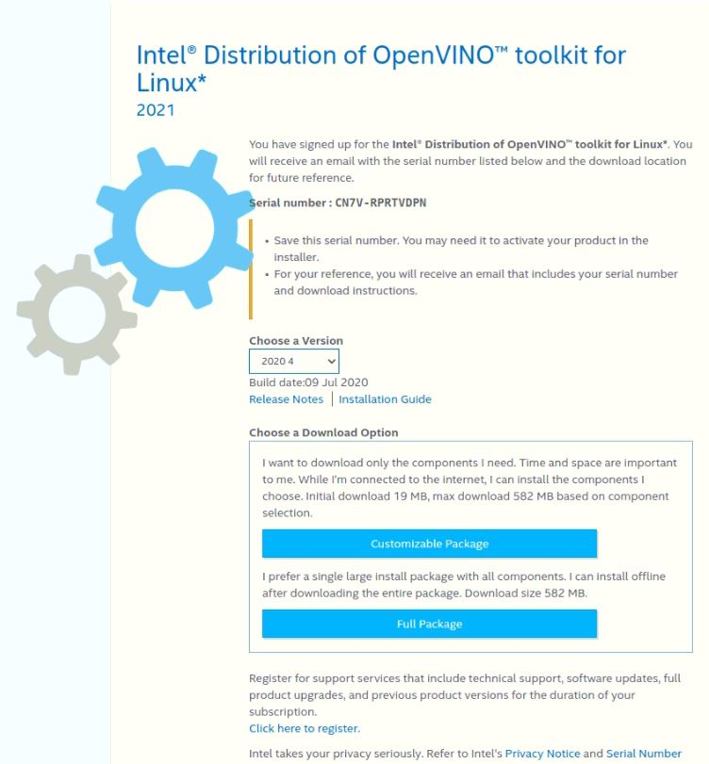
OpenVINO Toolkit

Slide 27
Install the Toolkit
Install External Software Dependencies
Set the OpenVINO Environment Variables
Configure the Model Optimizer
Run the Verification Scripts to Verify Installation
Compile Samples
Steps for Intel GPU
Run a Sample Application
Notes:
初始是用CPU，如果要用GPU要再跑相關步驟

Slide 28
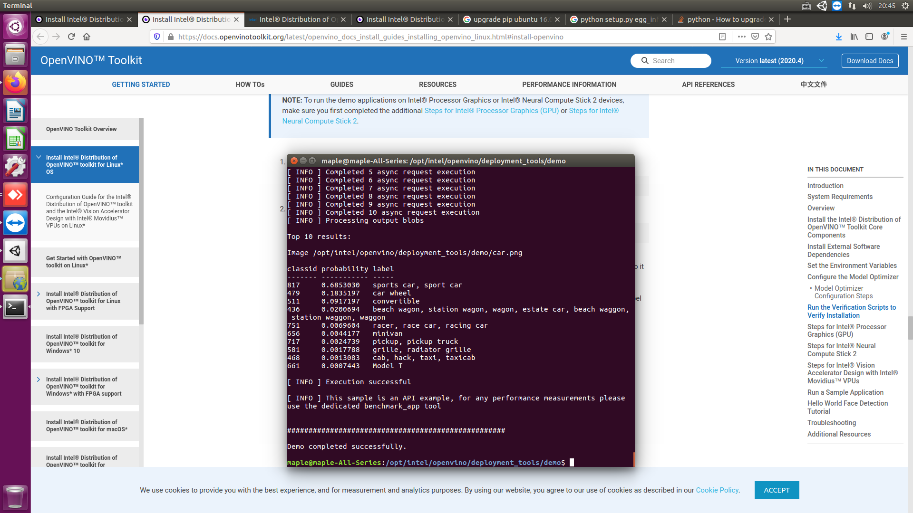
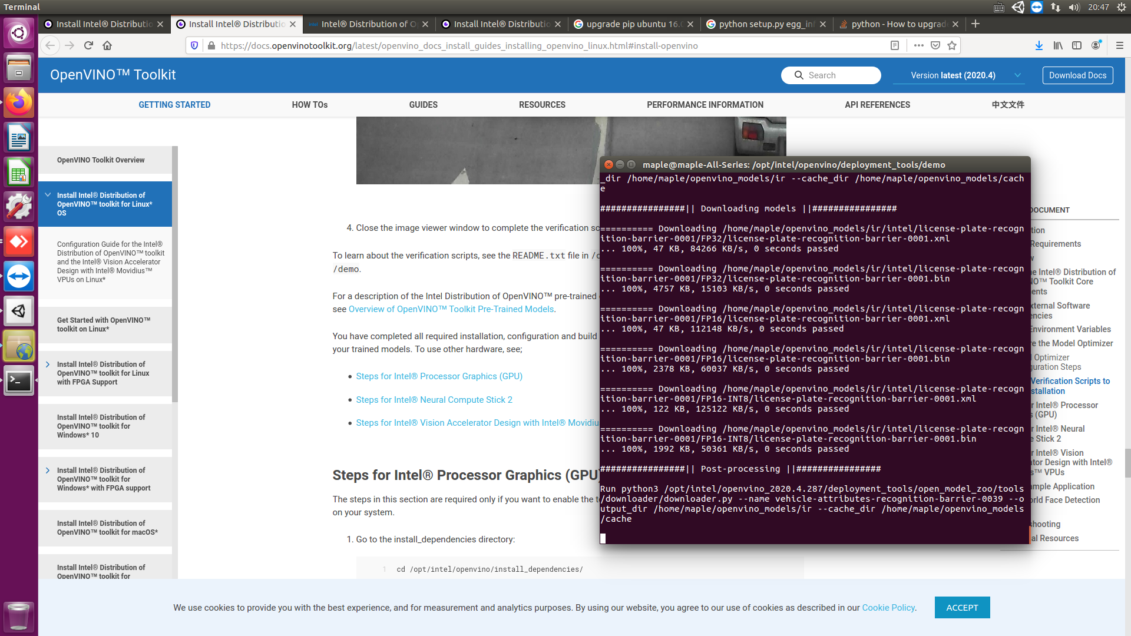

Slide 29
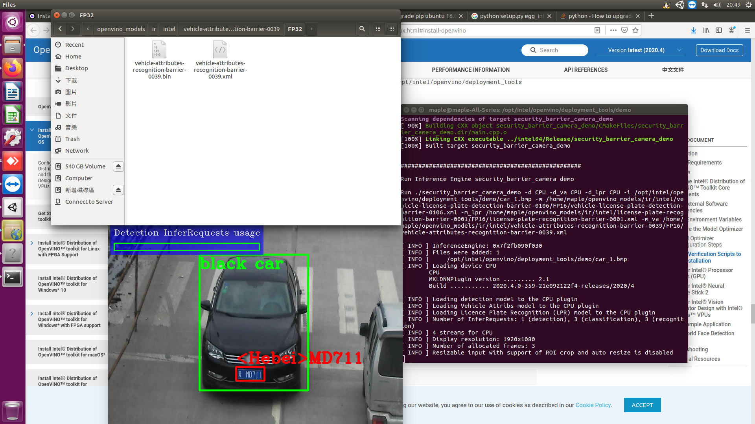

Slide 30
demo_squeezenet_download_convert_run.sh
Step1: Download the model and the prototxt of the model
Step2: Configure Model Optimizer (Install dependencies)
Step3: Convert a model with Model Optimizer
Step4: Build Inference Engine samples
Step5: Run Inference Engine classification samples
demo_security_barrier_camera.sh
Step1: Downloading Intel models
Step2: Build samples
Step3: Run samples
Notes:
Prototxt 原型

Slide 31
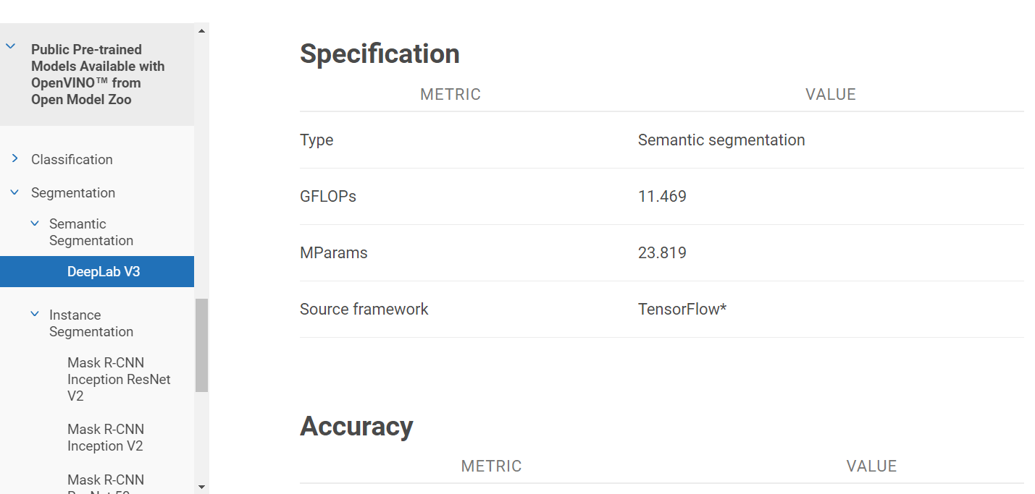
Public Pretrained Models from OpenVINO Open Zoo
GFLOPs: Giga FLoating point Operation Per second

Slide 32
Versions (in Anaconda3)
python3 == (3.8.5)
pip3 == (20.2.3)
tensorflow == (2.2.0)
numpy == (1.19.1)
keras == (2.4.3)
opencv-python == (4.4.0)
keras-segmentation == (0.3.0)
git == (2.7.4)

Slide 33
Typical Solder Defects
Solder voids
Air bubbles contained in solder during reflow.
Insufficient solder wettability of solder paste.
Solder voids can decrease solder strength, and partially decreased strength can then cause solder cracks.
Grown solder cracks can generate Joule heating and cause fire, they need careful inspection.
Notes:
Joule heating 焦耳加熱、電流熱效應

Slide 34
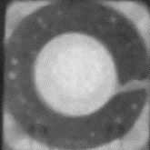
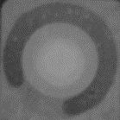
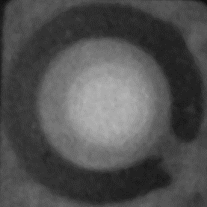
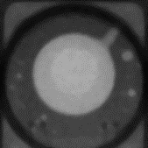
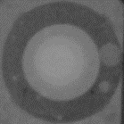
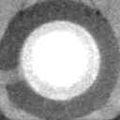
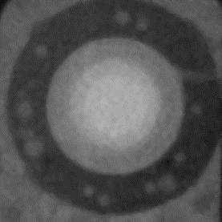
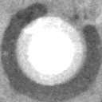
Typical Solder Defects
Solder voids / solder cracks
Notes:
QFN (Quad Flat No leads，四方平面無引腳封裝)
Non-wetting空焊

Slide 35
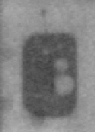
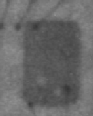
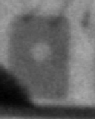
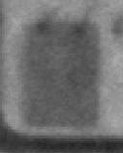
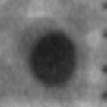
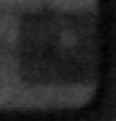
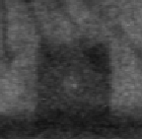
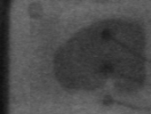
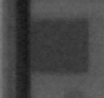
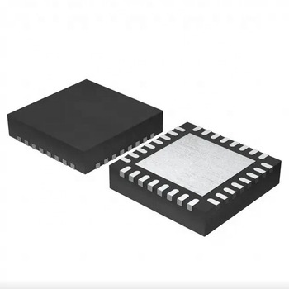
Typical Solder Defects
Solder voids
QFN (Quad Flat No leads)
Notes:
QFN (Quad Flat No leads，四方平面無引腳封裝)
Non-wetting 空焊

Slide 36





Typical Solder Defects
Non-wetting
QFN (Quad Flat No leads)
Notes:
QFN (Quad Flat No leads，四方平面無引腳封裝)
Non-wetting 空焊

Slide 37


Typical Solder Defects
Visualizing
Notes:
QFN (Quad Flat No leads，四方平面無引腳封裝)
Non-wetting空焊

Slide 38
Data
MIC images == 30 張 (128x128 - 277x277 pixels)
Pad_FQAPAP9 == 80 張 (128x177 pixels)
Pad_Huaian == 144 張 (128x128 - 128x133 pixels)
Pad_MFlex == 99 張 (128x177, 139x141-148x141 pixels)
Pad_QHD == 80 張 (128x160 pixels)
Pad_SZ == 100 張 (mostly 137x129 pixels)
Pad_WS == 100 張 (114x128 - 130x128 pixels)
共 633 張

Slide 39
Data
Training Data
MIC images: (3)，(1) … (11) == 27 張
Pad_FQAPAP9: (1) ~ (75) == 75 張
Pad_Huaian: (1) ~ (134) == 134 張
Pad_Mflex: (1) ~ (52)，(54) ~ (94) == 93 張
Pad_QHD: (1) ~ (75) == 75 張
Pad_SZ: (1) ~ (93) == 93 張
Pad_WS: (1) ~ (93) == 93 張
共 590 張

Slide 40
Data
Testing Data
MIC images: (12) ~ (14) == 3 張
Pad_FQAPAP9: (76) ~ (80) == 5 張
Pad_Huaian: (135) ~ (144) == 10 張
Pad_Mflex: (95) ~ (100) == 6 張
Pad_QHD: (76) ~ (80) == 5 張
Pad_SZ: (94) ~ (100) == 7 張
Pad_WS: (94) ~ (100) == 7 張
共 43 張

Slide 41
Label
0: voids in microphone
1: cracks in microphone
2: normal solder pad
3: voids in solder pad
4: non-wetting
255: background

Slide 42


VGG-Unet
Currently no data augmentation, preprocessing.
256 output classes ==> 6 output classes

Slide 43







Slide 44


Slide 45
Method
Python
Tensorflow
Unet model
DL semantic segmentation
OpenVINO
Steps
Label x-ray files from 0 to 5
Training (Unet)
Testing (output segmented images)
Import our model onto machine by OpenVINO

Slide 46
Result

Slide 47
References
Shervin Minaee, Yuri Boykov, Fatih Porikli, Antonio Plaza, Nasser Kehtarnavaz, Demetri Terzopoulos, "Image Segmentation Using Deep Learning: A Survey, " https://medium.com/swlh/image-segmentation-using-deep-learning-a-survey-e37e0f0a1489, 2020.
Mennatullah Siam, Senthil Yogamani, Mostafa Gamal, Moemen Abdel-Razek, Martin Jagersand, Hong Zhang, “Microsoft HoloLens 2, ” https://openaccess.thecvf.com/content_cvpr_2018_workshops/papers/w12/Siam_A_Comparative_Study_CVPR_2018_paper.pdf, 2018.
SH Tsang, “Encoder Decoder Architecture, Using Max Pooling Indices to Upsample, Outperforms FCN, DeepLabv1, DeconvNet, ” https://mc.ai/review-segnet-semantic-segmentation/, 2019.
Rayan Potter, “How To Label Data For Semantic Segmentation Deep Learning Models?, ” https://medium.com/anolytics/how-to-label-data-for-semantic-segmentation-deep-learning-models-907a996f95f7, 2019.
陳明佐, “Dilation Convolution, ” https://medium.com/我就問一句-怎麼寫/dilation-convolution-d322febe0621, 2019.
其他, "深度學習中 經常提到的 end to end 的理解, " https://www.itread01.com/content/1546712649.html, 2019.
Ethan Yanjia Li, "12 Papers You Should Read to Understand Object Detection in the Deep Learning Era, " https://towardsdatascience.com/12-papers-you-should-read-to-understand-object-detection-in-the-deep-learning-era-3390d4a28891, 2020.
WYL, "MULTI -SCALE CONTEXT AGGREGATION BY DILATED CONVOLUTIONS, " https://medium.com/@wangyilingtw/膨脹卷積-18ef5b24e5b4, 2019.
余昌黔, "【總結】圖像語義分割之FCN和CRF, " https://zhuanlan.zhihu.com/p/22308032, 2017.
demi, "上採樣，反捲積，上池化概念區別, " http://imgtec.eetrend.com/blog/2019/100045215.html, 2019.
Mr.AMM, "圖像語義分割：FCN, " https://zhuanlan.zhihu.com/p/42488078, 2018.

Slide 48
References
Wikipedia, "影格率, " https://zh.wikipedia.org/wiki/帧率, 2012.
Evan Shelhamer∗, Jonathan Long∗, Trevor Darrell, "Fully Convolutional Networks for Semantic Segmentation, " https://arxiv.org/abs/1605.06211, 2016.
Philipp Krahenbuhl, Vladlen Koltun, "Efficient Inference in Fully Connected CRFs with Gaussian Edge Potentials, " https://papers.nips.cc/paper/4296-efficient-inference-in-fully-connected-crfs-with-gaussian-edge-potentials.pdf, 2011.
Vijay Badrinarayanan, Alex Kendall, Roberto Cipolla, "SegNet: A Deep Convolutional Encoder-Decoder Architecture for Image Segmentation, " https://arxiv.org/abs/1511.00561, 2015.
Hyeonwoo Noh, Seunghoon Hong, Bohyung Han, "Learning Deconvolution Network for Semantic Segmentation, " https://arxiv.org/abs/1505.04366, 2015.
Liang-Chieh Chen, George Papandreou, Iasonas Kokkinos, Kevin Murphy, Alan L. Yuille, "DeepLab: Semantic Image Segmentation with Deep Convolutional Nets, Atrous Convolution, and Fully Connected CRFs, " https://arxiv.org/abs/1606.00915, 2017.
AINLP, "NLP硬核入門-條件隨機場CRF, " https://www.jishuwen.com/d/pgKM/zh-tw, 2019.
huahualu, "Atrous Convolution, " https://medium.com/轉職資工迷途記/atrous-convolution-bc03c31b0a03, 2018.
shine-lee, "一文搞懂deconvolution、transposed convolution、sub-pixel or fractional convolution, " https://www.cnblogs.com/shine-lee/p/11559825.html, 2019.
Tommy Huang, "卷積神經網路(Convolutional neural network, CNN):卷積計算中的步伐(stride)和填充(padding), " https://medium.com/@chih.sheng.huang821/卷積神經網路-convolutional-neural-network-cnn-卷積計算中的步伐-stride-和填充-padding-94449e638e82, 2018.

Slide 49
References
Divam Gupta, "A Beginner’s guide to Deep Learning based Semantic Segmentation using Keras, " https://divamgupta.com/image-segmentation/2019/06/06/deep-learning-semantic-segmentation-keras.html, 2019.
Derrick Mwiti, "A 2019 Guide to Semantic Segmentation, " https://heartbeat.fritz.ai/a-2019-guide-to-semantic-segmentation-ca8242f5a7fc, 2019.
Derrick Mwiti, "Image segmentation in 2020: Architectures, Losses, Datasets, and Frameworks, " https://neptune.ai/blog/image-segmentation-in-2020, 2020.
surfacemountprocessteam, "SURFACE MOUNT PROCESS, " http://www.surfacemountprocess.com/, 2015.
Volkan YILMAZ, "Elastic Deformation on Images, " https://towardsdatascience.com/elastic-deformation-on-images-b00c21327372, 2019.
小小將, "你必須要知道CNN模型：ResNet, " https://zhuanlan.zhihu.com/p/31852747, 2018.
小小將, "DenseNet：比ResNet更優的CNN模型, " https://zhuanlan.zhihu.com/p/37189203, 2018.
Arunava, "ENet — A Deep Neural Architecture for Real-Time Semantic Segmentation, " https://towardsdatascience.com/enet-a-deep-neural-architecture-for-real-time-semantic-segmentation-2baa59cf97e9, 2019.
Vijay Badrinarayanan, Alex Kendall, Roberto Cipolla, "SegNet: A Deep Convolutional Encoder-Decoder Architecture for Image Segmentation, " https://arxiv.org/pdf/1511.00561.pdf, 2016.
清華阿羅, "EfficientNet-可能是迄今為止最好的CNN網絡, " https://zhuanlan.zhihu.com/p/67834114#ref_6, 2020.

Slide 50
References
Divam Gupta, "A Beginner’s guide to Deep Learning based Semantic Segmentation using Keras, " https://divamgupta.com/image-segmentation/2019/06/06/deep-learning-semantic-segmentation-keras.html, 2019.
divamgupta, "image-segmentation-keras, " https://github.com/divamgupta/image-segmentation-keras, 2020.
itread01, "論文：PSPNet-Pyramid scene parsing Network，閱讀筆記, " https://www.itread01.com/content/1546370642.html, 2019.
Hengshuang Zhao, Jianping Shi, Xiaojuan Qi, Xiaogang Wang, Jiaya Jia, "Pyramid Scene Parsing Network, " https://arxiv.org/abs/1612.01105, 2017.
cs231n, "Transfer Learning, " https://cs231n.github.io/transfer-learning/, unknown.
G SowmiyaNarayanan, "Image Segmentation Using Mask R-CNN, " https://towardsdatascience.com/image-segmentation-using-mask-r-cnn-8067560ed773, 2020.
Kaiming He, Georgia Gkioxari, Piotr Dollar, Ross Girshick, "Mask R-CNN, " https://arxiv.org/pdf/1703.06870.pdf, 2018.
OleguerCanal, "cpp-python_socket, " https://github.com/OleguerCanal/cpp-python_socket/tree/optional_opencv/cpp, 2019.
arnavguddu, "Embedding Python program in a C/C++ code, " https://www.codeproject.com/Articles/820116/Embedding-Python-program-in-a-C-Cplusplus-code?fbclid=IwAR1yj_fq5yZxnsu98Tdi6pmSF4FSaBmvKRcXsDemG8RRyBb7Ex0WmjNVoJw, 2014.
tonyl, "MFC中調用Python, " https://www.twblogs.net/a/5b7e433b2b71776838563af4?fbclid=IwAR0kO9sQJOqJKXCXX3DXB1EPAEJARj6WhWyFl0jVQntAsEqsBCA6Puhohok, 2018.

Slide 51
References
李宏毅, "DL/ML Tutorial, " http://speech.ee.ntu.edu.tw/~tlkagk/courses_ML20.html?fbclid=IwAR2Scsfkd6qO6zWpsrXxjwBzrJdc34EIz6zaOFp3O6aM6ZZyae8vIZqvv74, 2019.
陳明佐, "Transfer Learning 轉移學習, " https://medium.com/我就問一句-怎麼寫/transfer-learning-轉移學習-4538e6e2ffe4, 2019.
KC YEN, "2020.08.10(一) ～ 2020.08.14(五), " https://hackmd.io/x4GJG_mPRkWz7h5wpI5Ckw?view, 2020.
KC YEN, "2020.08.10(一) ～ 2020.08.14(五), " https://hackmd.io/x4GJG_mPRkWz7h5wpI5Ckw?view, 2020.
KC YEN, "2020.08.24(一) ～ 2020.08.28(五), " https://hackmd.io/lT6_pwwZSPK-bCNOODkxYQ?both, 2020.
KC YEN, "2020.08.31(一) ～ 2020.09.04(五), " https://hackmd.io/OzBjjvc0SLWK6J8h31YnMg?both, 2020.
Jessy Li 潔西李, "OpenVINO- The Model Optimizer, " https://medium.com/@ssuchieh/openvino-the-model-optimizer-2617e43bda9f, 2020.
divamgupta, "image-segmentation-keras, " https://github.com/divamgupta/image-segmentation-keras, 2020.
OpenVINO, "OpenVINO Toolkit, " https://docs.openvinotoolkit.org/, 2020.
Grady Huang, "【邊緣AI系列】 OpenVINO 懶人包, " https://medium.com/@grady1006/邊緣ai系列-openvino-懶人包-55f357ceae75, 2020.

